Slide 1
Asia pacific college’s aircon management system

Slide 2
Facility management (FM)
The premises and services required to accommodate and facilitate business activity
-Bernard (1996)

Slide 3





FACILITY MANAGEMENT
Definitions throughout the years
1990
2000
International Facility Management Association
2016
IBM Watson Internet of Things
Nourse
Nutt
Frost & Sullivan
Seldom aware of the overall corporate strategic planning
Resource management, at strategic and operational levels of support.
Encompasses multiple disciplines to ensure functionality of the built environment by integrating people, place, process and technology.
Property management, and energy management is the key driver of the acceleration of service integration and growth in IFM.
Technology is changing how buildings are used – but It can also help you adapt your facilities management strategy to rapid change

Slide 4
Integrated Facility management (IFM)
Method of consolidating many or all of your office’s services under one contract and management team.
-Frost and Sullivan

Slide 5
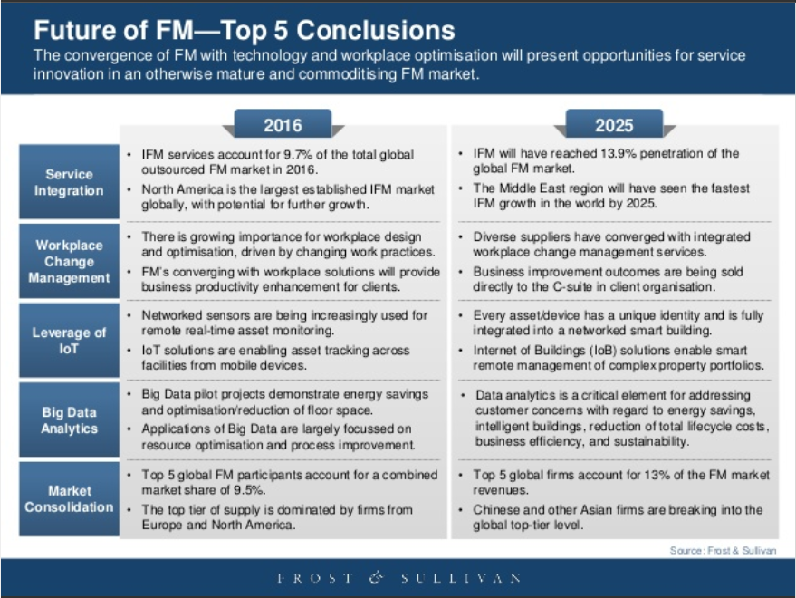

Slide 6
FM IN APC
Facilities are manually operated by the Security Department
Basis in turning on or off certain facilities are the class schedules and reservations

Slide 7
Reservation Clerk | Scope of Responsibility
Receptionist (4th floor) | Reservations on classrooms - both laboratories and lectures, auditorium, multi-purpose hall 1 and 2, parking, and basketball court made by members of APC.
ITRO (5th floor) | Computer laboratories.
Library (7th floor) | Discussion room B and C, Game Library, and Audio-Visual Room.
Engineering and Laboratory Sciences (8th floor) | Laboratories in the 8th floor, projects lab, and open lab.
Building Administration (10th floor) | Reservations on classrooms - both laboratories and lectures, auditorium, multi-purpose hall 1 and 2, parking, and basketball court made by outsiders.

Slide 8
FM in APC (Cont.)
Different protocols are made in different types of rooms
Schedules are provided by the receptionist to the security guards for them to operate the facilities
Two security guards are tasked to operate the facilities, namely Sky One and Sky Two

Slide 9
FM in APC (Cont.)
Air conditioners are turned on 10 to 20 minutes before a class starts and turned off once the class is dismissed
Laboratory rooms are locked and sometimes lecture rooms are not

Slide 10
General Objectives
Create a program that will simulate the operation of air conditioner
Justify the costing of implementation of an IoT solution to operate the facilities

Slide 11
Specific Objectives
Create a program for a Raspberry Pi 3 that will simulate the operation of an IoT solution using the following modules:
LED, to represent as a trigger for the IR transmitter
PIR Motion sensor, to detect movement in a room

Slide 12
Specific Objectives (Cont.)
The trigger will be used to present the operation of air conditioner inside the room. Accompanied by a database, whereby the class schedules will be manually inputted. The database will be used by the device as reference to operate the facility

Slide 13
Specific Objectives (Cont.)
Create a web-based reporting system, to monitor air conditioner, with the following present modules:
Login

Slide 14
Specific Objectives (Cont.)
Create a web-based reporting system, to monitor air conditioner, with the following present modules:
Login
Feedback of the facility based on its operation

Slide 15
Specific Objectives (Cont.)
The future modules that will be added are:
Administrator account that oversees the following:
Managing accounts
Overseeing reports
Setting user privileges

Slide 16
Specific Objectives (Cont.)
A tabular view for searching and viewing of organized data sent by the IoT device –that operates the facility, providing the following:
Feedback from the operation of facilities
A real-time report for the current time of the day
A summary report for all the operation of facilities

Slide 17
Specific Objectives (Cont.)
A tabular format for the list of reports made by users with details such as:
Time and date
Description of report
Room number

Slide 18
Specific Objectives (Cont.)
Justify the costing of an implementation of an IoT solution to automate the operation of air conditioners in APC, through forecasting of the expenses incurred by a weekly and monthly, and how much is wasted

Slide 19
Scope and Limitations
All air conditioners that are not inside the classrooms with class schedules will not be covered by the IoT device
The operation of the facilities will only follow the class schedules provided by the registrar that is stored in APCIS
The content of the project will follow the client’s request and any suggestion will be immediately addressed

Slide 20
Review of Related Literature
Meeting Room Monitoring
Konica Minolta Laboratory Europe (KMLE) Solution
Smart Meeting Rooms – Intel IoT
Conference Room Truth Serum
Meeting Room Booking System (MBRS)
Open Source Hassle-Free Booking System for Schools
Open Space

Slide 21
ROOM RESERVATION SYSTEMS | AUTOMATED RESERVATION | MANUAL RESERVATION | PREVENTS BOOKING CONFLICTS | DISPLAYS CURRENT STATUS OF ROOM | DETECTS ROOM OCCUPENCY | IOT BASED | PROVIDES ANALYSIS REPORT
Meeting Room Monitoring | ✓ | ✕ | ✓ | ✓ | ✓ | ✓ | ✓
KMLE Solution | ✓ | ✕ | ✓ | ✓ | ✓ | ✓ | ✓
Smart Meeting Rooms - Intel IoT | ✓ | ✓ | ✓ | ✓ | ✓ | ✓ | ✕
Conference Room Truth Serum | ✓ | ✕ | ✓ | ✓ | ✓ | ✓ | ✕
Meeting Room Booking System (MRBS) | ✓ | ✕ | ✓ | ✓ | ✕ | ✓ | ✕
Open Source Hassle-free Room Booking System for Schools | ✓ | ✕ | ✓ | ✓ | ✕ | ✕ | ✓
One Space | ✓ | ✓ | ✓ | ✓ | ✕ | ✕ | ✓
Proposed system | ✓ | ✓ | ✓ | ✓ | ✓ | ✓ | ✓

Slide 22
Technical Background
Facility Management
Integrated Facility Management
Internet of Things
Intelligent Enterprise
Living Services
IoT Big Data Platforms
Signal Processing

Slide 23
EVENT TABLE

Slide 24
Event | Trigger | Source | Use Case | Response | Destination
Provide Class Schedules. | Start of a New Term. | APCIS | Provide updated class schedules. | Class Schedule Details. | IOT CLIENT
Operation of air conditioner/s. | Class Schedules. | APCIS | Checks class schedule details. | Process Class Schedule Details. | IOT CLIENT
Reserving a room. | Reservation of a room. | USER | Manage reservation of room. | Manages reservation. | APCIS
Activation of the air conditioner/s and/or switch fuse. | Based on Class Schedules. | APCIS | Activates the air conditioner/s and/or switch fuse in a room. | Activates the switch fuse if there is one in a room, and air conditioner/s itself 15 minutes before the time allocated. | IOT CLIENT

Slide 25
Event | Trigger | Source | Use Case | Response | Destination
Deactivates the air conditioner/s and/or switch fuse. | Turning off Facilities if: Professor is absent Class is dismissed Early dismissal Class suspension After the 5 minutes that the sensors had not detected any movement in a room. | APCIS | Deactivates air conditioner/s and/or switch fuse in a room. | Air conditioner and/or switch fuse are deactivated. | IOT CLIENT
Reactivating the air conditioner/s in a room. | From a deactivated air conditioner/s and/or switch fuse, turns on the air conditioner/s and/or switch fuse after detecting consistent movement for 1 minute if there is still time allocated in a room. | APCIS | Reactivation of air conditioner/s and/or switch/ fuse | Reactivates the air conditioner/s and/or switch fuse of the air conditioner. | IOT CLIENT

Slide 26
Event | Trigger | Source | Use Case | Response | Destination
IoT Client sends feedback. | The time facilities are turned on and/or off. | IOT CLIENT | Sends feedback. | Provide reports based on the feedback. | APCIS
The consolidation of processed feedback details. | All classes for the day has ended. | IOT CLIENT | Process report. | Provide a summary report of the processed reports. | APCIS

Slide 27
GAP ANALYSIS

Slide 28
Strategic Objective | Current Standing | Deficiency | Action Plan
The facilities are turned on minutes before the class or event starts. | Sky One or Sky Two turns on and the facilities manually based on class schedules and reservations that most of the time delayed. | Hindering the students to utilize the time provided by the course. | Implementation of an IoT device that is placed on fused and on the IR receiver of the air conditioner to turn on such without any manpower.
The facilities are turned off in the event: That there is no class Early dismissal Professor is not present Suspension of classes | Sky One or Sky Two turns off the facilities manually that is most of the time inaccurate. | Failure to turn off facilities on time. Underutilized usage of facilities resulting to increase in utilities and depreciation expense. | The receptionist addresses to Sky One or Sky Two that there is no class, an early dismissal, or the professor is not present.
Broken facilities are replaced or fixed as soon as possible. | Broken facilities are only replaced or fixed when noticed. | Broken facilities are usually left ignored when left unused. | Have the professor report the defective facilities to offices in charge.

Slide 29
Description of Prototype
Raspberry Pi 3
PIR Motion Sensor
Raspbian Jessie
LED
MySQL
Python

Slide 30
Features of the System
The air conditioners in a room will be activated 15 minutes before class starts, this is to cool off the room before the class starts
The classroom will be activated after deactivating, when the sensors had detected consistent movement for 1 minute and there is a class schedule

Slide 31
Features of the System (Cont.)
The air conditioner will be deactivated when:
Class is dismissed
The facilities will continue to operate in cases when the class was dismissed and no movement was detected after 5 minutes, but there is only 15 minutes before the next class

Slide 32
Features of the System (Cont.)
Early dismissal
Class suspension
No movement was detected after 5 minutes in a room

Slide 33
1 air conditioner | COST | 2 air conditioners | COST | 3 air conditioners | COST
Raspberry Pi Model 3 | ₱2,399.75 | Raspberry Pi Model 3 | ₱2,399.75 | Raspberry Pi Model 3 | ₱2,399.75
Raspberry Pi Power Supply | 399.75 | Raspberry Pi Power Supply | 399.75 | Raspberry Pi Power Supply | 399.75
PIR Motion Sensor (3 pcs) | 499.75 | PIR Motion Sensor (6 pcs) | 899.50 | PIR Motion Sensor (6 pcs) | 899.50
IR Transmitter | 58.75 | IR Transmitter (2 pcs) | 117.50 | IR Transmitter (3 pcs) | 176.25
Wirings and Cable Management | 450.00 | Wirings and Cable Management | 675.00 | Wirings and Cable Management | 900.00
Micro SD Card 16GB | 249.00 | Micro SD Card 16GB | 249.00 | Micro SD Card 16GB | 249.00
Servo Motors (1 pc) | 250.00 | Servo Motors (1 pc) | 250.00 | Servo Motors (1 pc) | 250.00
3D Printed Case | 350.00 | 3D Printed Case | 350.00 | 3D Printed Case | 350.00
Labor | 100.00 | Labor | 100.00 | Labor | 100.00
Total | ₱4,757.00 | Total | ₱5,440.50 | Total | ₱5,724.25

Slide 34
ROOM | Acquisition Cost per Room | ROOM | Acquisition Cost per Room
302 | 5440.50 | 802 | 5440.50
304 | 5440.50 | 805 | 5440.50
305 | 5440.50 | 809 | 5724.25
306 | 5440.50 | 811 | 5440.50
307 | 5440.50 | 813 | 5440.50
308 | 5440.50 | 815 | 5440.50
309 | 5724.25 | 816 | 5440.50
314 | 5440.50 | 817 | 5440.50
316 | 5440.50 | 818 | 5440.50
318 | 5440.50 | 1013 | 5440.50
409 | 5724.25 | 1014 | 5440.50
415 | 5440.50 | 1015 | 5440.50
416 | 5440.50 | 1016 | 5440.50
417 | 5440.50 | 1017 | 5440.50
418 | 5440.50 | 1018 | 5440.50
505 | 5440.50 | 1114 | 5440.50
515 | 5440.50 | 1115 | 5440.50
518 | 5440.50 | 1117 | 5440.50
602 | 5440.50 | 508A | 4757.00
604 | 5440.50 | 508-A | 4757.00
606 | 5440.50 | 508B | 4757.00
608 | 5440.50 | 609A | 4757.00
613 | 5440.50 | 609B | 4757.00
801 | 5440.50 | 609C | 4757.00
Total Acquisition Cost of Equipment |  |  | ₱257,894.25

Slide 35
REPLACEMENT COST
 | 1st Year | 2nd Year | 3rd Year
Number of Raspberry Pi | 48 | 43.2 | 34.56
Failure Rate per Year | 10% | 20% | 30%
 | 4.8 | 8.64 | 10.368
Replacements |  | 0.48 | 0.864
 |  |  | 0.912
TOTAL UNITS TO BE REPLACED (₱4,315.5/unit) | 4.8 | 9.12 | 12.144
REPLACEMENT COST PER YEAR | ₱20,714.40 | ₱39,357.36 | ₱52,407.43
PER TERM | ₱6,904.8 | ₱13,119.12 | ₱17,469.14

Slide 36
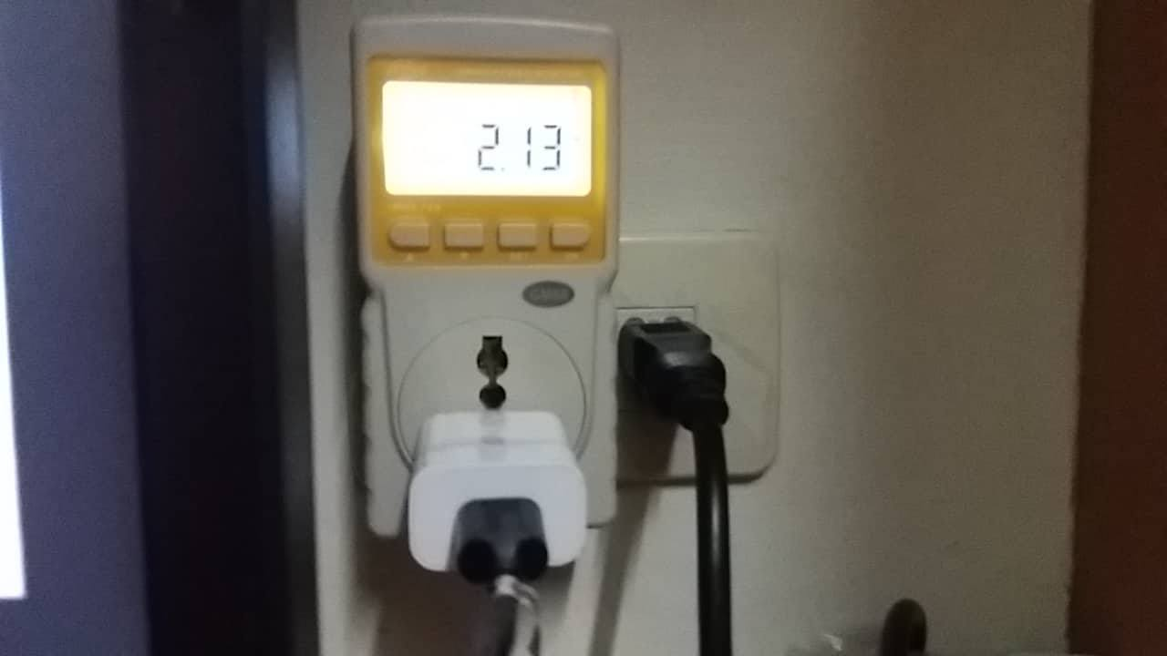
Raspberry Pi 3 with modules operating 12.5 hours a day | ₱153.71

Slide 37
Maintenance Cost and Operation Cost per Term (1st Year)
Electrical Expense | 153.71
Replacement Cost | 6,904.80
TOTAL | ₱7,058.51
Maintenance Cost and Operation Cost per Term (2nd Year)
Electrical Expense | 153.71
Replacement Cost | 13,119.12
TOTAL | ₱13,272.83
Maintenance Cost and Operation Cost per Term (3rd Year)
Electrical Expense | 153.71
Replacement Cost | 17,469.14
TOTAL | ₱17,622.85

Slide 38
Implementation of IoT must be done in floors with the highest amount of class schedules
FLOOR | HOURS
8th | 245.67
6th | 186
3rd | 172
10th | 124
4th | 52
11th | 46
5th | 42

Slide 39
COST | 1st Year | 2nd Year | 3rd Year
ELECTRICAL EXPENSE | 461.13 | 461.13 | 461.13
REPLACEMENT COST | 20,714.40 | 39,357.36 | 52,407.42
TOTAL ANNUAL EXPENSE | 21,175.53 | 39,818.49 | 52,868.55
ACQUISITION COST | 257,894.25
TRAINING | 20,000.00
EXPENSE FOR THE YEAR | 299,069.78 | 39,818.49 | 52,868.55
SAVINGS | 150,670.17 | 150,670.17 | 150,670.17
NET GAIN/LOSS | (₱148,399.61) | ₱110,851.68 | ₱97,801.62

